Slide 1
Tosca Automation Testing
Presenter name: Balaji Dinakaran

Slide 2
Table of contents
Introduction
Tosca TestSuite
Benefits
Key features
Test Automation
Test Management works
Tosca Continuous Testing
Test Management works
Test Execution and Reporting
Conclusion
Notes:
Image source: https://www.inviul.com/selenium-tutorials/

Slide 3
Introduction
TOSCA (Test Orchestration, Automation, and Standardization) is a framework for automated testing that provides a model-based approach for defining, designing, and managing test cases and test assets. TOSCA Testing is a methodology and toolset that aims to streamline the entire testing process by focusing on standardization, reusability, and automation.
Notes:
Image source: https://www.inviul.com/selenium-tutorials/

Slide 4
What is TOSCA? TOSCA is a model-based test automation tool by Tricentis that allows automation without scripting using reusable modules.
What type of tool is Tosca?
Model-based automation tool
Scriptless automation tool
Enterprise-grade testing tool (a tool or application that meets the rigorous standards and requirements of large-scale enterprises or organizations)
What are the main Tosca components?
Tosca Commander → Design, manage, and execute test cases
Tosca Executor → Dedicated execution agent (often used for unattended/distributed execution)
Repository → Stores test artifacts
DEX → Distributed execution engine (Distributed Execution for running tests across multiple machines)

Slide 5
Benefits
Common Language and Framework: TOSCA provides a standardized language and framework for defining and executing tests, ensuring consistency across the testing process.
Consistent Quality: Standardized testing practices lead to consistent quality assurance across projects and teams.
Automation: TOSCA enables the automation of test cases, reducing the need for manual intervention and significantly speeding up the testing process.
Parallel Execution: TOSCA supports parallel execution of tests across multiple environments and configurations, further enhancing testing efficiency.
Notes:
Image source: https://www.fitaacademy.in/blog/benefits-of-learning-selenium-automation-testing/

Slide 6
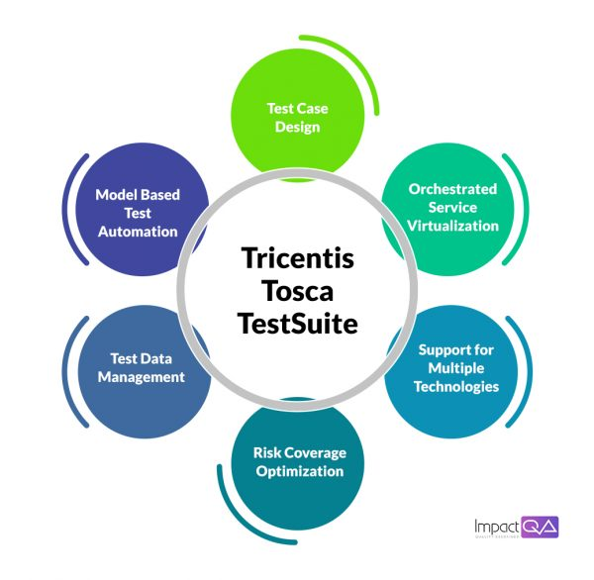
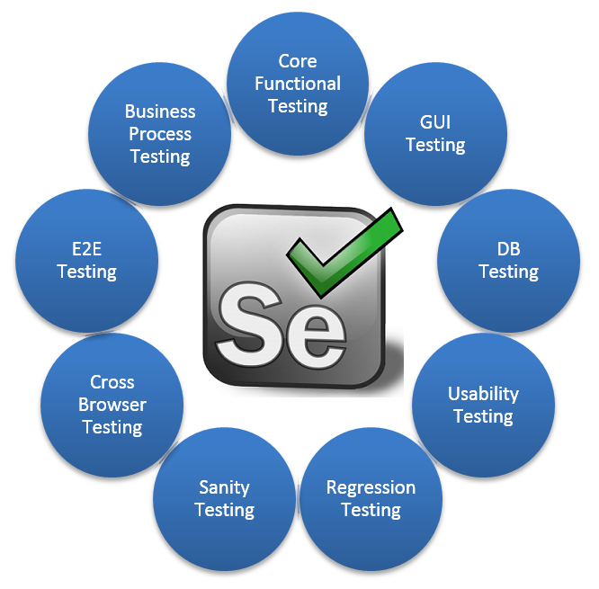
Tosca TestSuite
Notes:
Image source: https://www.inviul.com/selenium-tutorials/

Slide 7
What is Workspace in Tosca? Workspace is the environment where all test assets (modules, test cases, execution lists) are stored.
What is a TestCase? A TestCase is a set of steps that defines a complete business flow.
What is a Module? A Module represents UI elements (like username, password, buttons).
What is a Tosca Repository? A central storage location where all test assets are saved and shared.
What is XScan used for? XScan is used to identify UI elements from web applications and create modules.

Slide 8
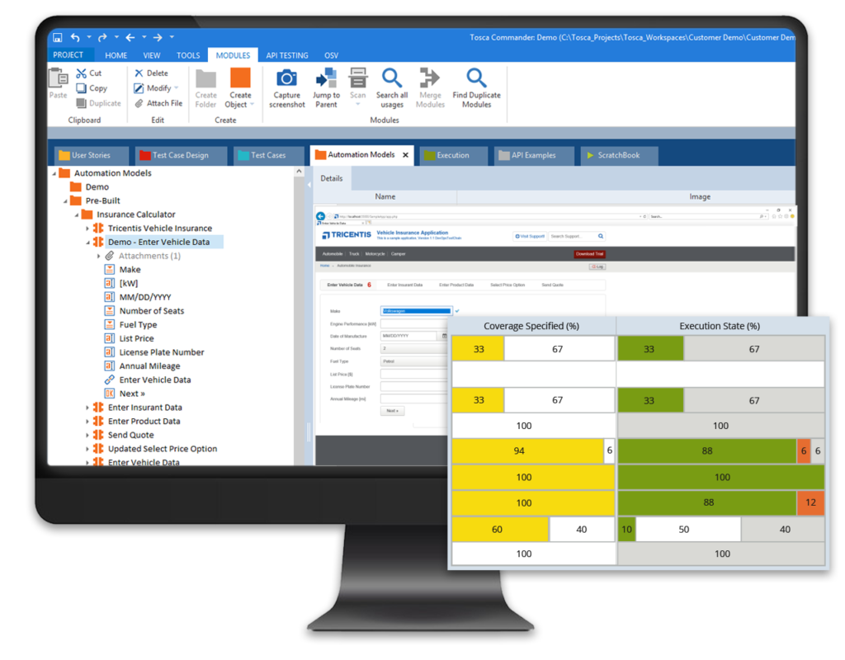
Test Automation
Tosca Test Suite allows the creation of automated test cases using a model-based approach.
It provides a graphical user interface for test design, making it easy to create and maintain test cases.
Tosca Test Suite supports various technologies, including web, desktop, mobile, and API testing.
Notes:
Image source: https://in.pinterest.com/pin/selenium-ide-open-source-record-and-playback-test-automation-for-the-web--715087247067662988/

Slide 9
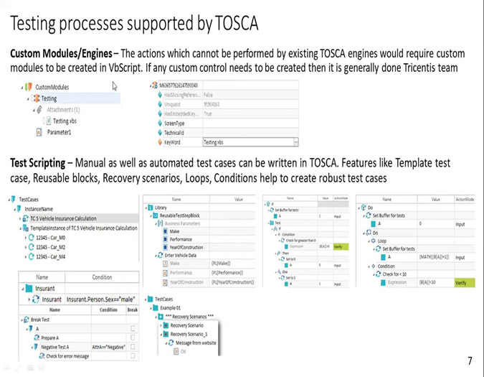
Test Management works
Notes:
Image source: https://devopedia.org/test-frameworks

Slide 10
Tosca Continuous Testing
Tosca Test Suite supports continuous testing, enabling the integration of testing into the DevOps pipeline.
It seamlessly integrates with popular CI/CD tools, ensuring continuous integration and delivery.
Tosca Continuous Testing helps accelerate software delivery without compromising on quality.
Notes:
Image source: http://www.softwaretestingmaterial.com/page-object-model/

Slide 11
Test Execution and Reporting
Tosca Test Suite offers a powerful test execution engine.
It provides real-time visibility into test execution progress and results.
Tosca Test Suite generates comprehensive test reports, allowing for effective test analysis and reporting.
Notes:
Image source: https://www.gcreddy.com/2018/08/selenium-integration-with-other-tools.html

Slide 12
Conclusion
TOSCA (Test Orchestration, Automation, and Standardization) Testing presents a robust framework for modern software testing needs. By emphasizing automation, standardization, and collaboration, TOSCA Testing offers numerous advantages to organizations striving to enhance their testing processes and deliver high-quality software products efficiently.
Notes:
Image source: https://www.educba.com/selenium-automation-testing/

Slide 13

Thank you
Notes:
Image source: https://www.educba.com/selenium-automation-testing/

